Slide 1
Data Warehousing and Data Mining TBC-604(1)

Slide 2
Syllabus
UNIT 1 : Introduction to Data Warehousing
Concept of Data Warehouse, DBMS verses data warehouse, Data Marts, Metadata, Multidimensional data model, Multidimensional database, Data warehouse Measures, their categorization and computation, Multi-dimensional database hierarchies.
UNIT 2 : Data Warehouse Architecture
Operations in OLAP, Advantages of OLAP over OLTP, Three-Tier Data Warehouse architecture, OLAP Guidelines, Multidimensional versus Multirelational OLAP , Categories of Tools, OLAP Tools and the Internet
Unit 3: Introduction to Data Mining
Basic Concepts of Data Mining; Data Mining primitives: Task-relevant data, mining objective, measures and identification of patterns, KDD versus data mining, data mining tools and applications.
Data Mining Query Languages: Data specification, specifying kind of knowledge, hierarchy specification, pattern presentation & visualization specification, data mining languages and standardization of data mining, Architectures of Data Mining Systems.

Slide 3
Syllabus
UNIT 4 : Data Mining Techniques
Association rules: Association rules from transaction database & relational database, correlation analysis; Classification and predication using decision tree induction. Introduction to Clustering techniques, partition method, and Hierarchical method.
UNIT 5 : Overview of Advanced Features of Data Mining
Mining complex data objects, Spatial databases, Multimedia databases, Time series and Sequence data; mining Text Databases and mining Word Wide Web.

Slide 4
What Is a Data Warehouse?
A single, complete and consistent store of data obtained from a variety of different sources made available to end users in a what they can understand and use in a business context.

Slide 5
The data warehouse is an informational environment
Provides an integrated and total view of the enterprise
Makes the enterprise’s current and historical information easily available for decision making
Makes decision-support transactions possible without hindering operational systems
Renders the organization’s information consistently
Presents a flexible and interactive source of strategic information

Slide 6
“A data warehouse is a subject-oriented, integrated, time-variant, and nonvolatile collection of data in support of management’s decision-making process.”—W. H. Inmon
Data warehousing:
The process of constructing and using data warehouses

Slide 8
Features of Data Warehousing
Subject Oriented: The Data Warehouse is Subject Oriented because it provides us the information around a subject rather the organization's ongoing operations.
These subjects can be product, customers, suppliers, sales, revenue etc.
The data warehouse does not focus on the ongoing operations Rather it focuses on modelling and analysis of data for decision making.

Slide 9
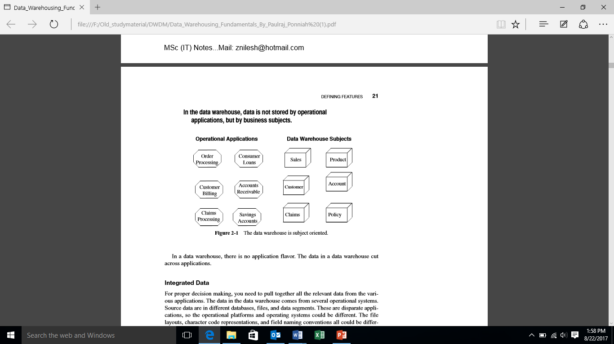
Claims under automobile insurance policies are processed in the Auto Insurance application, similarly claim for compensation of workers is organized in workers’ compensation application.

Slide 10
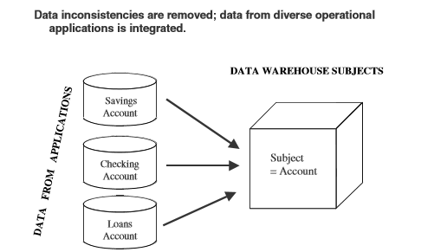
Integrated:-The data in DWH is integrated in the sense that data from the disparate system as well as the data from different application will be accumulated and will be stored in the single database called DWH(This process is known as ETL in DWH.) for analysis and decision taking purpose.

Slide 11
Time variant:
In OLTP the data will be stored according for current values unlike in Data Warehouse, the data will be stored for time which may range from 1 year to 10 years.
This aspect of data warehouse is quite significant for both the design and implementation phase.
It helps in analysis of the past, correlates with the present scenario and to predict for the future.

Slide 12
Non-Volatile:
We add change or delete the data from an operational system as each transaction happens.
We do not delete the data from the data warehouse in the real time.
Once the data is captured in the data warehouse, we do not run individual transactions to change the data there.
Data warehouse can only be viewed.
DWH is used for analysing the data so it periodically get refreshed by picking up the data from various OLTP systems.

Slide 13
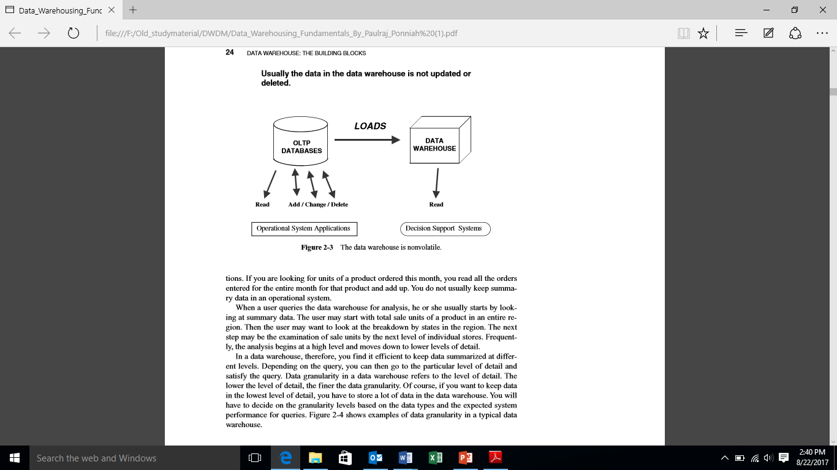

Slide 14
Data warehouse | Operational system
Subject oriented | Transaction oriented
Large (hundreds of GB up to several TB) | Small (MB up to several GB)
Historic data | Current data
De-normalized table structure (few tables, many columns per table) | Normalized table structure (many tables, few columns per table)
Batch updates | Continuous updates
Usually very complex queries | Simple to complex queries

Slide 15
Comparison between OLTP and OLAP system

Slide 16
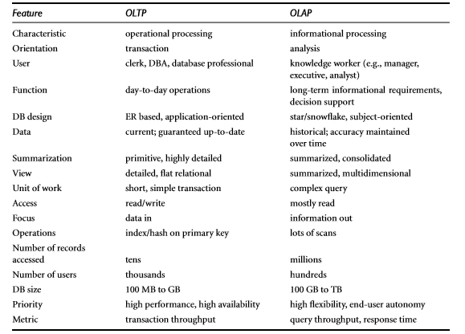

Slide 17
Data Warehouse and Data Mart
A data mart contains a subset of corporate wide data that is of value to a specific group of users.
The scope is confined to specific selected subjects.
The data contained in data marts tend to be summarized.
Data marts are usually implemented on low-cost departmental servers that are Unix/Linux- or Windows-based. The implementation cycle of a data mart is more likely to be measured in weeks rather than months or years.
However, it may involve complex integration in the long run if its design and planning were not enterprise-wide

Slide 18
Depending on the source of data, data marts can be categorized as independent or dependent..
Independent Data mart:-Independent data marts are sourced from data captured from one or more operational systems or external information providers, or from data generated locally within a particular department or geographic area.
Dependent data mart:- Dependent data marts are sourced directly from enterprise data warehouses.

Slide 19
Data Warehouse and Data Mart
S.no | Data warehouse | DataMart
1. | Corporate/Enterprise Wide | Departmental
2. | It is a unit of all data marts | It is a single business process
3 | Structure for corporate view of data | Structure to suit the departmental view of data
4 | Queries on presentation resource | Technology optimal for data access and analysis
5 | Data received from staging area Organized on E-R Model | Star-join(Facts & Dimensions)

Slide 20
Metadata
Metadata are data about data. When used in a data warehouse, metadata are the data that define warehouse objects

Slide 21
Metadata in a data warehouse contains the answers to questions about the data in the data warehouse. Metadata are data about data when used in a date warehouse, metadata are the data that define warehouse objects .
Categories of Metadata
Operational Metadata - Operational metadata contains all of this information about the operational data sources.
2. Extraction and Transformation Metadata – Extraction and transformation metadata contain data about the extraction of data from the source systems, namely, the extraction frequencies, extraction methods, and business rules for the data extraction. It also contain information about all the transformation that take place in the data staging area

Slide 22
3. End-User Metadata – It is the navigation map of the data warehouse. It enable the end users to find information from the data warehouse. The end user metadata allows the end-users to use their own business terminology and look for information in those ways in which they normally think of the business.

Slide 23
Metadata Repository: Metadata repository as a general-purpose information directory or cataloguing device to classify, store, and manage metadata.
Business metadata and technical metadata serve different purposes. The end-users need the business metadata; data warehouse developers and administrators require the technical metadata.
Therefore, the metadata repository can be thought of as two distinct information directories, one to store business metadata and the other to store technical metadata.
This division may also be logical within a single physical repository.

Slide 24
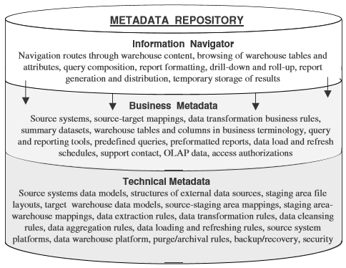

Slide 25
Technical Metadata: Technical metadata concentrates on support for the IT staff responsible for development, maintenance, and administration.
Technical metadata is more structured than business metadata.
Technical metadata is like an internal view of the data warehouse showing the inner details in technical terms.
examples of technical metadata:
Data models of source systems
Record layouts of outside sources
Source-to-staging area mappings
Staging area-to-data warehouse mappings
Data extraction rules and schedules
Data transformation rules and versioning
Data aggregation rules
Data cleansing rules
Summarization and derivations
Data loading and controls
Job dependencies
Program names and descriptions
Data warehouse data model
Database names
Table/view names
Column names and descriptions
Key attributes
Business rules for entities and relationships

Slide 26
Business metadata connects your business users to your data warehouse.
Business users need to know what is available in the data warehouse from a perspective different from that of IT professionals like you.
Business metadata is like a roadmap or an easy-to-use information directory showing the contents and how to get there.
Examples
Connectivity procedures
Security and access privileges
The overall structure of data in business terms
Source systems
Source-to-target mappings
Data transformation business rules
Summarization and derivations
Table names and business definitions
Attribute names and business definitions
Data ownership
Query and reporting tools
Predefined queries
Predefined reports
Report distribution information
Common information access routes
Rules for analysis using OLAP

Slide 27
Multidimensional Data Model

Slide 28
Data warehouses and OLAP tools are based on a multidimensional data model. This model views data in the form of a data cube

Slide 29
Stars, Snowﬂakes, and Fact Constellations: Schemas for Multidimensional Databases
The entity-relationship data model is commonly used in the design of relational databases, where a database schema consists of a set of entities and the relationships between them.
A data warehouse, however, requires a concise, subject-oriented schema that facilitates on-line data analysis.
The most popular data model for a data warehouse is a multidimensional model. Such a model can exist in the form of a star schema, a snowﬂake schema, or a fact constellation schema.

Slide 30
Star schema:
The most common modeling paradigm is the star schema, in which the data warehouse contains
a large central table (fact table) containing the bulk of the data, with no redundancy, and
a set of smaller attendant tables (dimension tables), one for each dimension.
The schema graph resembles a starburst, with the dimension tables displayed in a radial pattern around the central fact table.
Snowﬂake schema:
The snowﬂake schema is a variant of the star schema model, where some dimension tables are normalized, thereby further splitting the data into additional tables.
The resulting schema graph forms a shape similar to a snowﬂake.

Slide 31
The major difference between the snowﬂake and star schema models is that the dimension tables of the snowﬂake model may be kept in normalized form to reduce redundancies.
Such a table is easy to maintain and saves storage space.
Fact constellation: Sophisticated applications may require multiple fact tables to share dimension tables. This kind of schema can be viewed as a collection of stars, and hence is called a galaxy schema or a fact constellation.

Slide 32
Conceptual Modeling of Data Warehouses
Modeling data warehouses: dimensions & measures
Star schema: A fact table in the middle connected to a set of dimension tables
Snowflake schema: A refinement of star schema where some dimensional hierarchy is normalized into a set of smaller dimension tables, forming a shape similar to snowflake
Fact constellations: Multiple fact tables share dimension tables, viewed as a collection of stars, therefore called galaxy schema or fact constellation

Slide 33
Example of Star Schema
time
time_key
day
day_of_the_week
month
quarter
year
item
item_key
item_name
brand
type
supplier_type
Sales Fact Table
time_key
item_key
branch_key
branch
location
location_key
branch_key
branch_name
branch_type
location_key
street
city
state_or_province
country
units_sold
dollars_sold
avg_sales
Measures

Slide 34
Example of Snowflake Schema
time
item
time_key
day
day_of_the_week
month
quarter
year
item_key
item_name
brand
type
supplier_key
supplier
Sales Fact Table
supplier_key
supplier_type
time_key
item_key
branch_key
branch
location
location_key
location_key
street
city_key
branch_key
branch_name
branch_type
units_sold
dollars_sold
city
city_key
city
state_or_province
country
avg_sales
Measures

Slide 35
Example of Fact Constellation
time
time_key
day
day_of_the_week
month
quarter
year
item
Shipping Fact Table
item_key
item_name
brand
type
supplier_type
Sales Fact Table
time_key
time_key
item_key
shipper_key
item_key
branch_key
from_location
branch
location_key
location
to_location
branch_key
branch_name
branch_type
units_sold
location_key
street
city
province_or_state
country
dollars_cost
dollars_sold
units_shipped
avg_sales
shipper
Measures
shipper_key
shipper_name
location_key
shipper_type

Slide 36
A Concept Hierarchy: Dimension (location)
all
all
region
Europe
...
North_America
country
Germany
...
Spain
Canada
...
Mexico
city
Frankfurt
...
Vancouver
...
Toronto
office
L. Chan
...
M. Wind

Slide 37
Data Cube Measures: Three Categories
Distributive: if the result derived by applying the function to n aggregate values is the same as that derived by applying the function on all the data without partitioning
E.g., count(), sum(), min(), max()
Algebraic: if it can be computed by an algebraic function with M arguments (where M is a bounded integer), each of which is obtained by applying a distributive aggregate function
E.g., avg(), min_N(), standard_deviation()
Holistic: if there is no constant bound on the storage size needed to describe a subaggregate.
E.g., median(), mode(), rank()

